Slide 1
Stage 2 Moscow Theater Course Designer: Jon Gieser
Moscow Theater is a 28 round unlimited course. There are 11 paper targets and 6 poppers. The best two hits per target will score and steel must fall to score. The start signal is audible.
The Handgun start position is standing with toes touching marks and hands touching marks. Handgun loaded and holstered. The PCC start position is standing with toes touching marks and weak hand touching weak side mark. PCC loaded, safety on, muzzle touching strong side mark.
On the audible start signal, engage targets(and noshoots) from within the shooting areas. If you hit any no-shoot, ALL noshoots must have a hit on them when you are done. If you leave a noshoot un-hit, the penalty will apply. If you hit ALL noshoots or NO noshoots, there is no penalty. The penalty for leaving witnesses is 15 Procedurals. Red Steel is Shoot Steel White Steel is NoShoot Steel

Slide 2
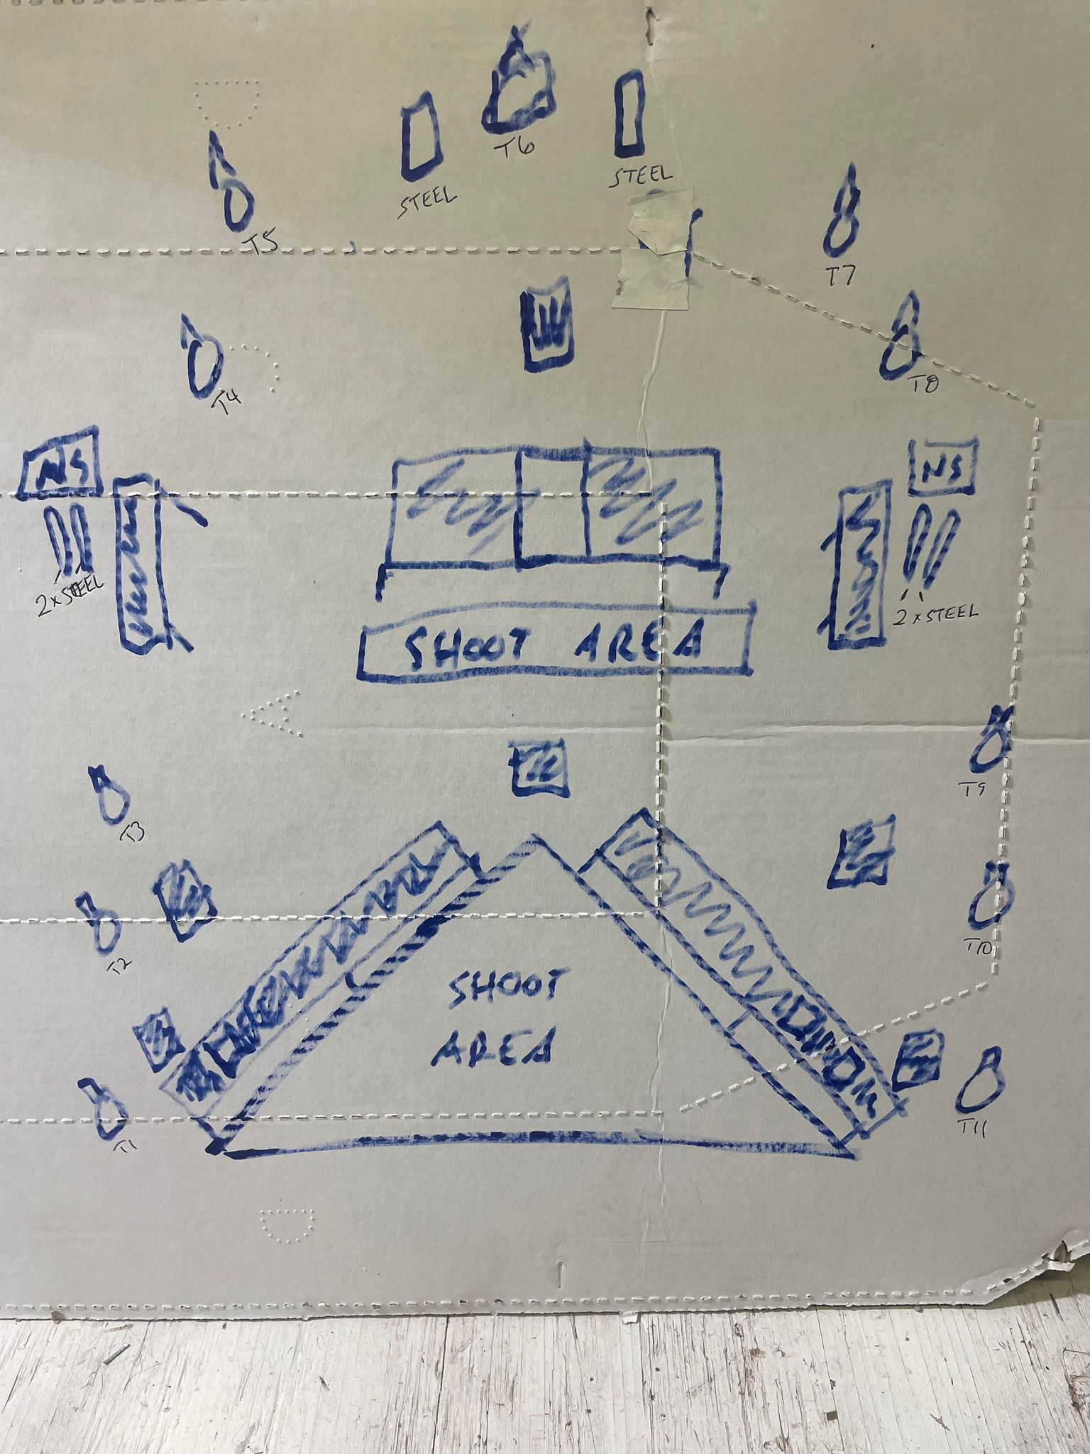
 | Stage 1, Bay 2 Moscow Theater Course Designer: Jon Gieser

